Slide 1
Ibn Battuta Discussion & Fundamental Structure Review

Slide 2
IBN Battuta
Discussion Questions
In what ways does Ibn Battuta's narrative differ from Benjamin of Tudela’s?
What draws Ibn Battuta’s interest while traveling?
What role does Islam play throughout the text?
How does Ibn Battuta respond to different cultures? In what ways is he affected or changed by them?
How do other cultures respond to Ibn Battuta? Are they also shaped by him?

Slide 3
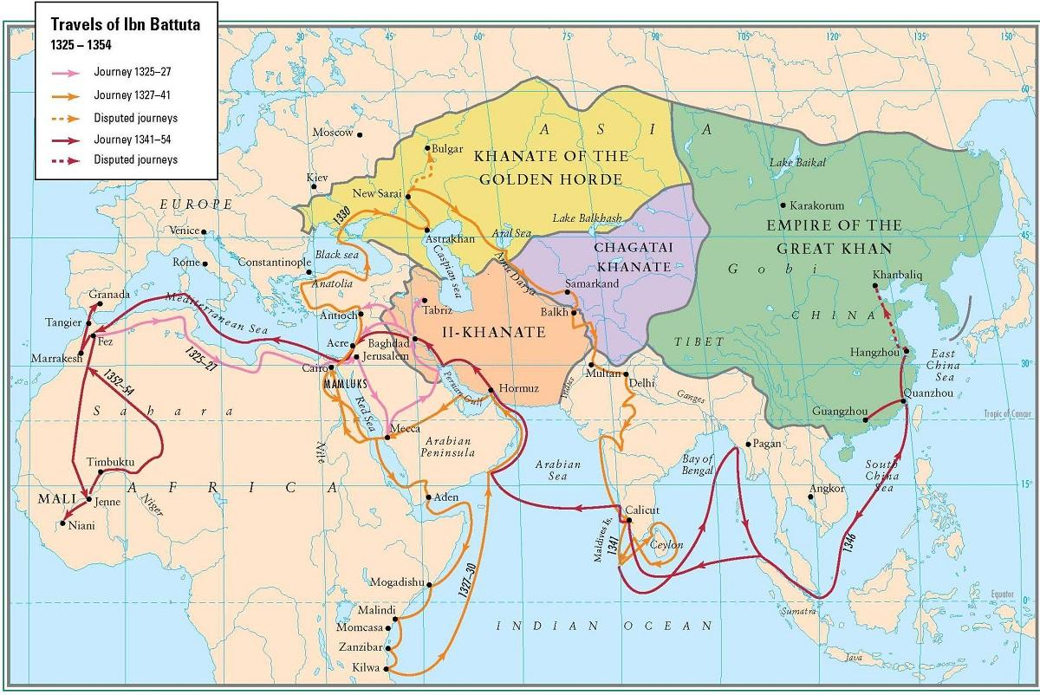
Ibn Battuta’s Itinerary

Slide 4
Elements of Academic Argument – Review
Problem
Established View
Flaw
Thesis
Motive
something difficult to understand; an ongoing conversation/question
a voice in the conversation; a proposed solution/answer
a concern about the EV’s validity
correction of the flaw; a better view; the product of the analysis
why this is important?; what’s at stake?; so what?
Notes:
The Five Elements in sum. Where do you see each of these elements in the sample abstract that I’ve handed out to you?

Slide 5
Fundamental Structure Review
The dramatic interpretation of [Geoffrey Chaucer’s] Canterbury Tales—which asserts that each tale, whatever its other purposes, is designed to reveal the personality of its teller—has a long and distinguished history. Its most influential modern exponent is undoubtedly George Lyman Kittredge, who flatly declared that “the Pilgrims do not exist for the sake of the stories, but vice versa.” […] Although the tellers and their interactions are certainly a part of Chaucer's total conception, modern critics, influenced by anachronistic ideas of characterization drawn largely from the realistic novel, have given them much too much importance. Very often the artistic complexity of the tales has been sacrificed to a futile search for psychological depth in the tellers.
I believe that the dramatic critics have got hold of the wrong end of the right stick. They are right to stress the individuality of Chaucer's tales but wrong to locate that individuality in the tellers. The real contest in the Canterbury Tales is between poems not pilgrims. Therefore, I suggest that, while recognizing the weaknesses of the dramatic theory, we should borrow its central insight—that every tale has its own voice—and apply it artistically instead of personally. None of the Canterbury Tales is fundamentally much like any other; each is constructed on its own individual literary principles and composed in its own special style, as if each were written by a separate poet.
C. David Benson, “Their Telling Difference: Chaucer the Pilgrim and his two Contrasting Tales,” The Chaucer Review, Vol. 18, No. 1 (1983), pp. 61-76

Slide 6
Fundamental Structure Review
The dramatic interpretation of [Geoffrey Chaucer’s] Canterbury Tales—which asserts that each tale, whatever its other purposes, is designed to reveal the personality of its teller—has a long and distinguished history. Its most influential modern exponent is undoubtedly George Lyman Kittredge, who flatly declared that “the Pilgrims do not exist for the sake of the stories, but vice versa.” […] Although the tellers and their interactions are certainly a part of Chaucer's total conception, modern critics, influenced by anachronistic ideas of characterization drawn largely from the realistic novel, have given them much too much importance. Very often the artistic complexity of the tales has been sacrificed to a futile search for psychological depth in the tellers.
I believe that the dramatic critics have got hold of the wrong end of the right stick. They are right to stress the individuality of Chaucer's tales but wrong to locate that individuality in the tellers. The real contest in the Canterbury Tales is between poems not pilgrims. Therefore, I suggest that, while recognizing the weaknesses of the dramatic theory, we should borrow its central insight—that every tale has its own voice—and apply it artistically instead of personally. None of the Canterbury Tales is fundamentally much like any other; each is constructed on its own individual literary principles and composed in its own special style, as if each were written by a separate poet.
C. David Benson, “Their Telling Difference: Chaucer the Pilgrim and his two Contrasting Tales,” The Chaucer Review, Vol. 18, No. 1 (1983), pp. 61-76

Slide 7
Fundamental Structure Review
The dramatic interpretation of [Geoffrey Chaucer’s] Canterbury Tales—which asserts that each tale, whatever its other purposes, is designed to reveal the personality of its teller—has a long and distinguished history. Its most influential modern exponent is undoubtedly George Lyman Kittredge, who flatly declared that “the Pilgrims do not exist for the sake of the stories, but vice versa.” […] Although the tellers and their interactions are certainly a part of Chaucer's total conception, modern critics, influenced by anachronistic ideas of characterization drawn largely from the realistic novel, have given them much too much importance. Very often the artistic complexity of the tales has been sacrificed to a futile search for psychological depth in the tellers.
I believe that the dramatic critics have got hold of the wrong end of the right stick. They are right to stress the individuality of Chaucer's tales but wrong to locate that individuality in the tellers. The real contest in the Canterbury Tales is between poems not pilgrims. Therefore, I suggest that, while recognizing the weaknesses of the dramatic theory, we should borrow its central insight—that every tale has its own voice—and apply it artistically instead of personally. None of the Canterbury Tales is fundamentally much like any other; each is constructed on its own individual literary principles and composed in its own special style, as if each were written by a separate poet.
C. David Benson, “Their Telling Difference: Chaucer the Pilgrim and his two Contrasting Tales,” The Chaucer Review, Vol. 18, No. 1 (1983), pp. 61-76

Slide 8
Fundamental Structure Review
The dramatic interpretation of [Geoffrey Chaucer’s] Canterbury Tales—which asserts that each tale, whatever its other purposes, is designed to reveal the personality of its teller—has a long and distinguished history. Its most influential modern exponent is undoubtedly George Lyman Kittredge, who flatly declared that “the Pilgrims do not exist for the sake of the stories, but vice versa.” […] Although the tellers and their interactions are certainly a part of Chaucer's total conception, modern critics, influenced by anachronistic ideas of characterization drawn largely from the realistic novel, have given them much too much importance. Very often the artistic complexity of the tales has been sacrificed to a futile search for psychological depth in the tellers.
I believe that the dramatic critics have got hold of the wrong end of the right stick. They are right to stress the individuality of Chaucer's tales but wrong to locate that individuality in the tellers. The real contest in the Canterbury Tales is between poems not pilgrims. Therefore, I suggest that, while recognizing the weaknesses of the dramatic theory, we should borrow its central insight—that every tale has its own voice—and apply it artistically instead of personally. None of the Canterbury Tales is fundamentally much like any other; each is constructed on its own individual literary principles and composed in its own special style, as if each were written by a separate poet.
C. David Benson, “Their Telling Difference: Chaucer the Pilgrim and his two Contrasting Tales,” The Chaucer Review, Vol. 18, No. 1 (1983), pp. 61-76

Slide 9
Fundamental Structure Review
The dramatic interpretation of [Geoffrey Chaucer’s] Canterbury Tales—which asserts that each tale, whatever its other purposes, is designed to reveal the personality of its teller—has a long and distinguished history. Its most influential modern exponent is undoubtedly George Lyman Kittredge, who flatly declared that “the Pilgrims do not exist for the sake of the stories, but vice versa.” […] Although the tellers and their interactions are certainly a part of Chaucer's total conception, modern critics, influenced by anachronistic ideas of characterization drawn largely from the realistic novel, have given them much too much importance. Very often the artistic complexity of the tales has been sacrificed to a futile search for psychological depth in the tellers.
I believe that the dramatic critics have got hold of the wrong end of the right stick. They are right to stress the individuality of Chaucer's tales but wrong to locate that individuality in the tellers. The real contest in the Canterbury Tales is between poems not pilgrims. Therefore, I suggest that, while recognizing the weaknesses of the dramatic theory, we should borrow its central insight—that every tale has its own voice—and apply it artistically instead of personally. None of the Canterbury Tales is fundamentally much like any other; each is constructed on its own individual literary principles and composed in its own special style, as if each were written by a separate poet.
C. David Benson, “Their Telling Difference: Chaucer the Pilgrim and his two Contrasting Tales,” The Chaucer Review, Vol. 18, No. 1 (1983), pp. 61-76

Slide 10
Fundamental Structure Review
The dramatic interpretation of [Geoffrey Chaucer’s] Canterbury Tales—which asserts that each tale, whatever its other purposes, is designed to reveal the personality of its teller—has a long and distinguished history. Its most influential modern exponent is undoubtedly George Lyman Kittredge, who flatly declared that “the Pilgrims do not exist for the sake of the stories, but vice versa.” […] Although the tellers and their interactions are certainly a part of Chaucer's total conception, modern critics, influenced by anachronistic ideas of characterization drawn largely from the realistic novel, have given them much too much importance. Very often the artistic complexity of the tales has been sacrificed to a futile search for psychological depth in the tellers.
I believe that the dramatic critics have got hold of the wrong end of the right stick. They are right to stress the individuality of Chaucer's tales but wrong to locate that individuality in the tellers. The real contest in the Canterbury Tales is between poems not pilgrims. Therefore, I suggest that, while recognizing the weaknesses of the dramatic theory, we should borrow its central insight—that every tale has its own voice—and apply it artistically instead of personally. None of the Canterbury Tales is fundamentally much like any other; each is constructed on its own individual literary principles and composed in its own special style, as if each were written by a separate poet.
C. David Benson, “Their Telling Difference: Chaucer the Pilgrim and his two Contrasting Tales,” The Chaucer Review, Vol. 18, No. 1 (1983), pp. 61-76

